Slide 1
shipping Instructions for lithium batteries
Dear customer,
Per regulation you as 'the sender' are responsible for the correct packaging and labelling of dangerous goods, and in the case of lithium batteries this depends on their type and rated Wh power.
We have summarized this, so you simply need to follow these 4 steps:
Identify your battery type and rated power (see your battery rating plate)
Identify the page in this document relevant to your battery:
Page 2 for Lithium Ion rated < 100Wh
Page 3 for Lithium Ion rated >=100Wh
Page 4 for Lithium Metal within some GX tools
Identify the scenario relevant to you
Pack accordingly

Slide 2
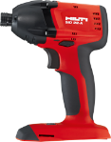
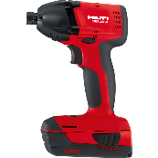
Lithium ion Batteries < 100 W/h
Applies when each battery in the box/case is rated < 100W/h.
For the labels to be valid their red frame must physically look red (colour printer required).
Scenario | Packing sequence | Packing notes | Package labelling | Documents
Cardboard box with only batteries |  | Unplug batteries from tools. Each battery must be packed in inner packaging that completely encloses it. Maximum 30kg per package. | Red frames must physically look red if this label is printed. | None
Cardboard box with batteries and tool(s) |  |  | Red frames must physically look red if this label is printed.
Hilti case where at least one battery is plugged to a tool |  | Each non-plugged battery must be packed in inner packaging that completely encloses it. The tool shall be equipped with an effective means of preventing accidental activation. Maximum 30kg per package.
Download & Print label >
Download & Print label >

Slide 3
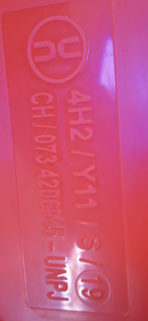
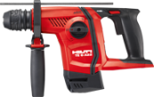
Lithium ion Batteries >=100 W/h
Scenario | Packing sequence | Packing notes | Package labelling | Documents
1) New Hilti Case INCLUDING print on bottom. If not follow scenario 5 |  |  |  | Enclose delivery note into plastic envelope and place on outside of the box
2) Cardboard box with only one battery |  |  | None extra, it is already printed on the special cardboard box.
3) Cardboard box with only batteries
4) Cardboard box with batteries and tool(s)
5) Cardboard box with batteries and tool(s) in a Hilti case
Check!
Hand-over DG documents to the driver

Slide 4
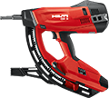
Lithium metal batteries within gx tools
Applies to the following gas-actuated fastening tools:
GX 120
GX 120-ME
GX 3
GX 3-ME
For the labels to be valid their red frame must physically look red (colour printer required).
Scenario | Packing sequence | Packing notes | Package labelling | Documents
Tool in a cardboard box |  | Only one tool per box. | Red frames must physically look red if this label is printed. | None
Tool in a Hilti case
Download & Print label >

